Slide 1

Limestone Federal Credit Union
Data Security Discussion 01-09-2024

Slide 2
Facebook
Wonderful tool to keep us connected.
Prime target for scams and data mining.
Don’t:
  Use a password that you use elsewhere.
  Share personal information.
  Answer surveys.
  When sharing a picture you share location information.

Slide 3
Facebook
Do:
Use a strong password.
Turn on Login Alerts.
Use Multi Factor Authentication (MFA).

Slide 4
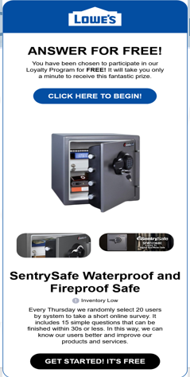
Common Scams - Email
Email: Looking for a click.
You Won!
It’s Free.
Logo is legitimate.

Slide 5
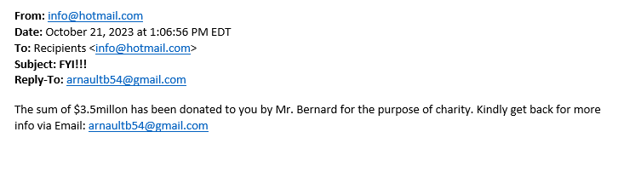
Common Scams - Email
Looking for a reply.

Slide 6
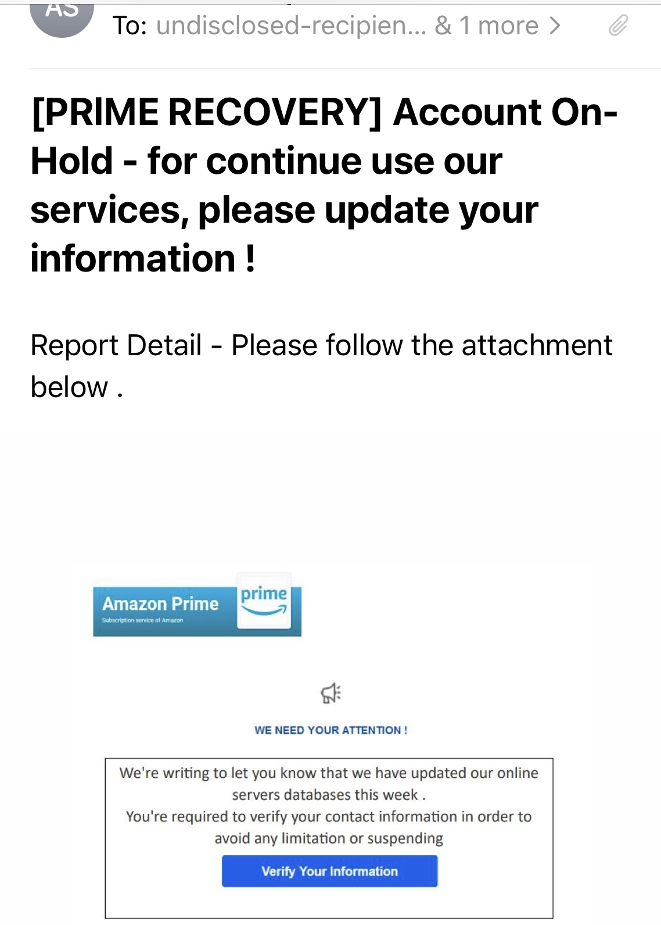
Common Scams - Email
Looking for a click.
Enter your information.
They get access to your legitimate account.
Logos look real.

Slide 7
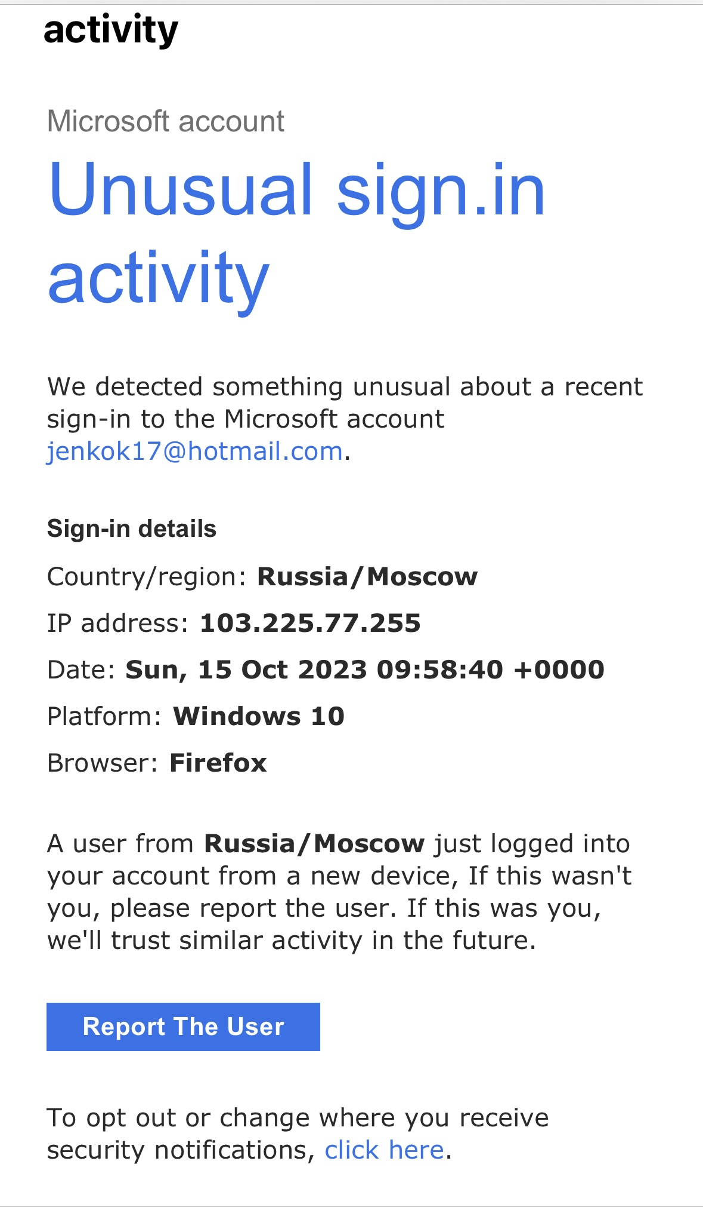
Common Scams - Email
Looking for a click.
“Trying” to help.
Enter your information.
They get access to your legitimate account.
Logos look real.

Slide 8
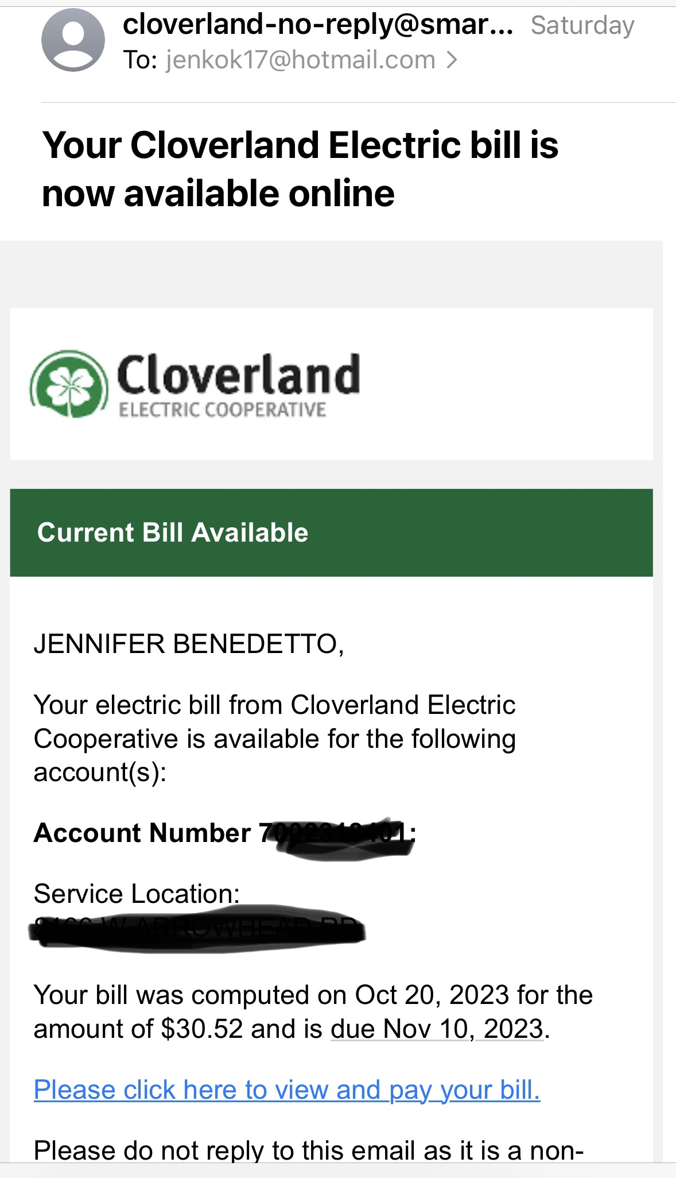
Common Scams - Email
Legitimate Email.
Even legitimate emails look suspicious.
Convenient, but we can take steps to avoid falling for fraud.

Slide 9
Common Scams - Email
How to protect yourself:
Think before you click, open, or reply.

Slide 10
Common Scams - Email
How to protect yourself:
If it looks odd, delete it.
If it sounds too good to be true, it probably is.
Hover over links.

Slide 11
Common Scams - Email
If You Think Its Legitimate:
Go to the website instead of using the link in the email.
Pay close attention to the sender’s address, misspelled words, and the overall tone of the email.

Slide 12
Common Scams - Email
Email scams will continue to be sent all day every day.
They are easy to mass produce and send.
It is easy to fall for.
It’s you against your inbox!

Slide 13
Common Scams - Phone Calls
We all likely have a phone in our pocket or in our home.
Phones are a prime target.
Callers can create a sense of urgency.
Callers can be smooth talking or kind.
Callers can have detailed information about you.

Slide 14
Common Scams - Phone Calls
Grandchild calling from jail.
Will often call from a spoofed number.
Can obtain grandchild’s name.
May explain inconsistencies with things like “I sound different because I have been hurt”
Request you send money or gift cards.

Slide 15
Common Scams - Phone Calls
Tax payment is past due.
Threaten to enforce levy.
Threaten with jail time.
Will accept multiple types of unusual payment forms: gift cards, Paypal, etc.

Slide 16
Common Scams - Phone Calls
Utility Payment Is Past Due
Will call pretending to be from a local utility vendor.
Threaten to turn off service.
Request payment in many different unusual forms: gift cards, Paypal, etc.

Slide 17
Common Scams - Texts
Track Your Amazon Package Text
Text you a link.
Tells you to click to track your package.
Humans are curious, we want to click. Don’t do it!

Slide 18
Common Scams - Phone Calls/Texts
How to protect yourself:
Think before you answer, click, open, or reply.

Slide 19
Common Scams - Fake Tech Support
Most Common In Our Community: Fake Virus and Tech Support Pop Ups
Will pop up on your device: phone, tablet, computer, etc.
Look incredibly legitimate.
When you call the number listed, they answer with the name of the support company in the pop up.
Appear to offer help and support.
Often want to log in and help fix the problem.

Slide 20
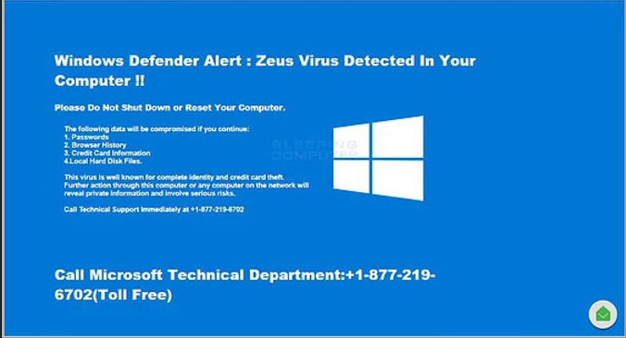
Common Scams - Fake Tech Support

Slide 21
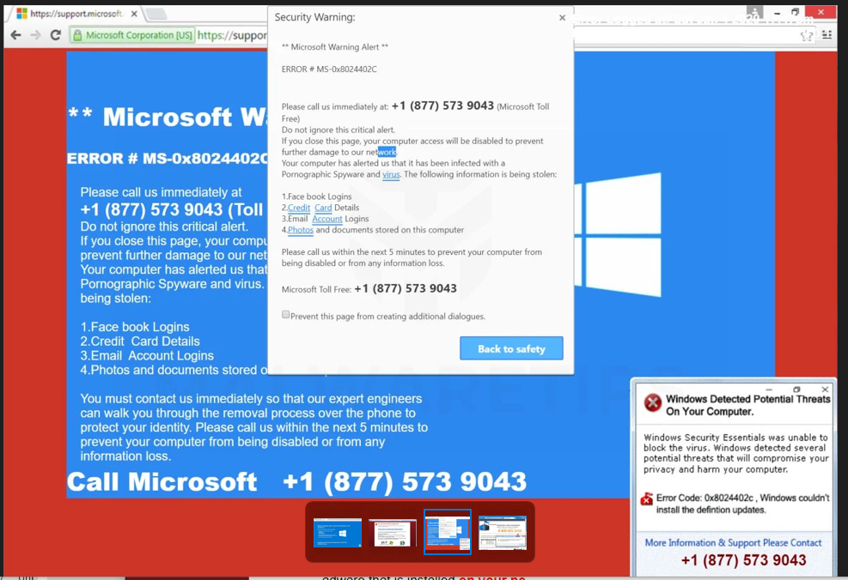
Common Scams - Fake Tech Support

Slide 22
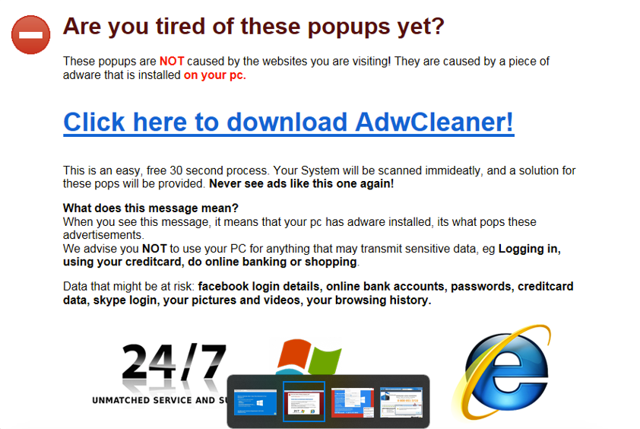
Common Scams - Fake Tech Support

Slide 23
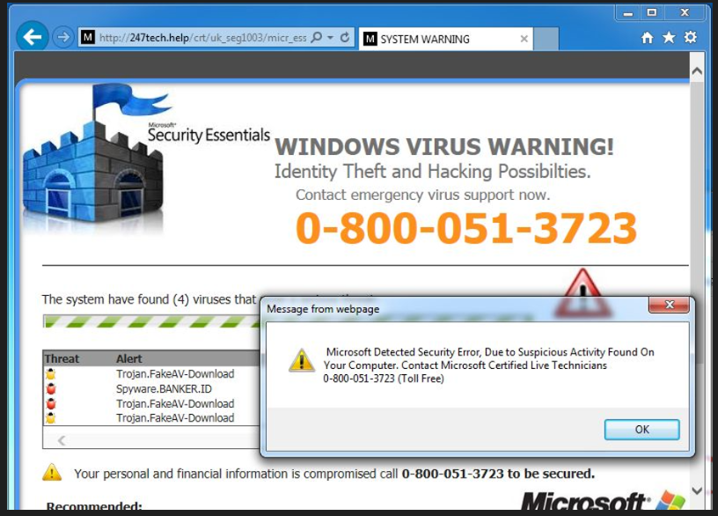
Common Scams - Fake Tech Support

Slide 24
What Can You Do?
Unfortunately there isn't one specific thing you can do to protect yourself.
Keep data security top of mind.
Maintain awareness.
Use caution.
Think before you act.

Slide 25
What Can You Do?
Change any default passwords if you buy new devices.
Use strong passwords.
Don’t hesitate to ask for help.

Slide 26
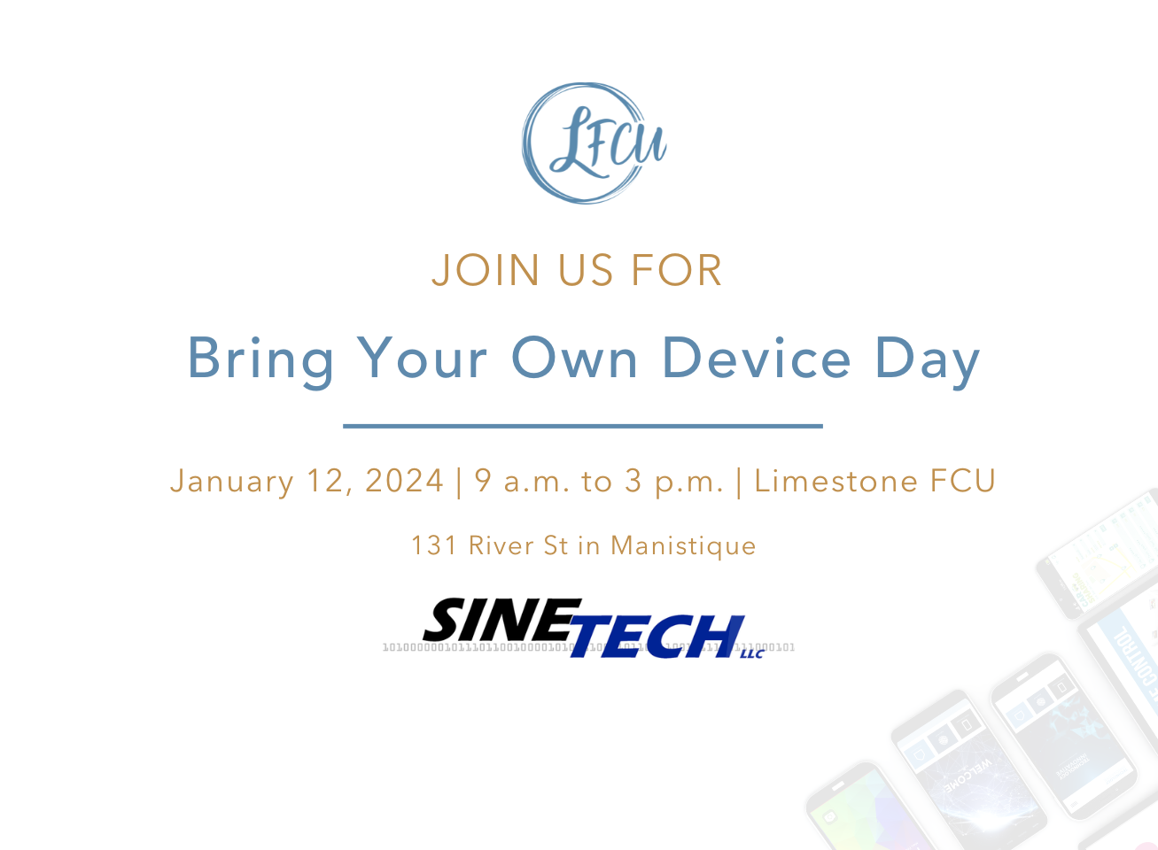
What Can You Do?
Members of Limestone FCU:
BYOD: Bring Your Own Device
  January 12 in Limestone FCU lobby.
KnowBe4 Course:
  In our mobile app and on home banking.
  Password: homecourse

Slide 27
What Can You Do?
SineTech is a great local resource for:
  Compromised devices.
  Ongoing scams.
  Security device sales.
  Discounts for being a LFCU member.

Slide 28
What Can You Do?
Protect your data like you would your purse or wallet.
Think before you act.
Ask for help if something seems off.

Slide 29
Thank you!

